Slide 1
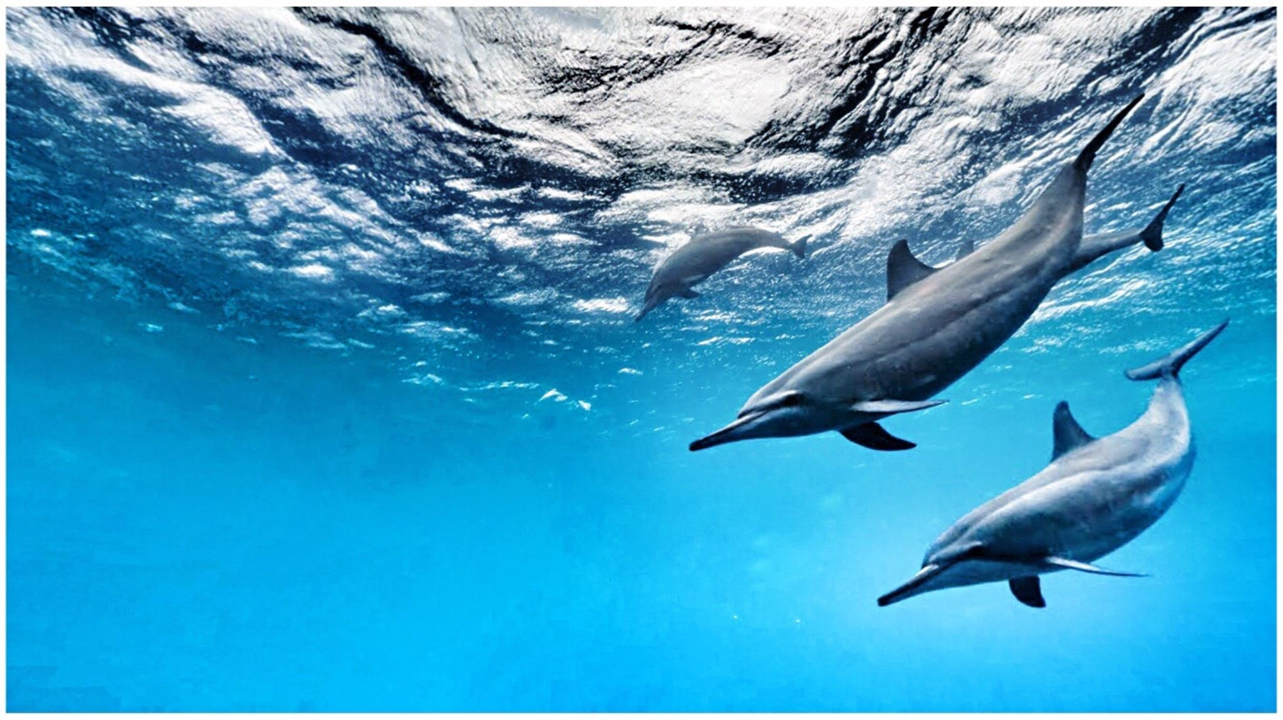
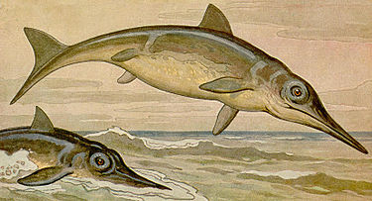
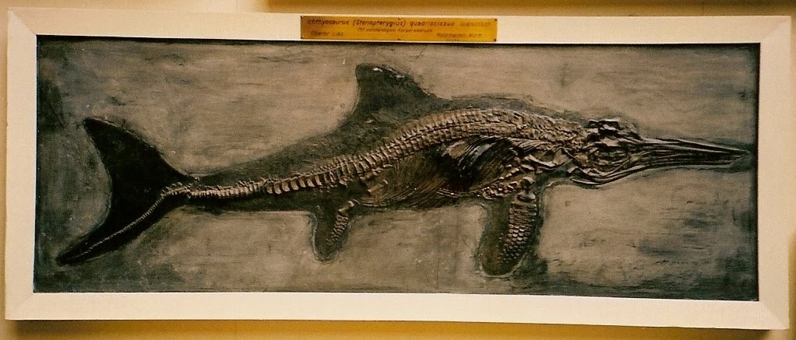
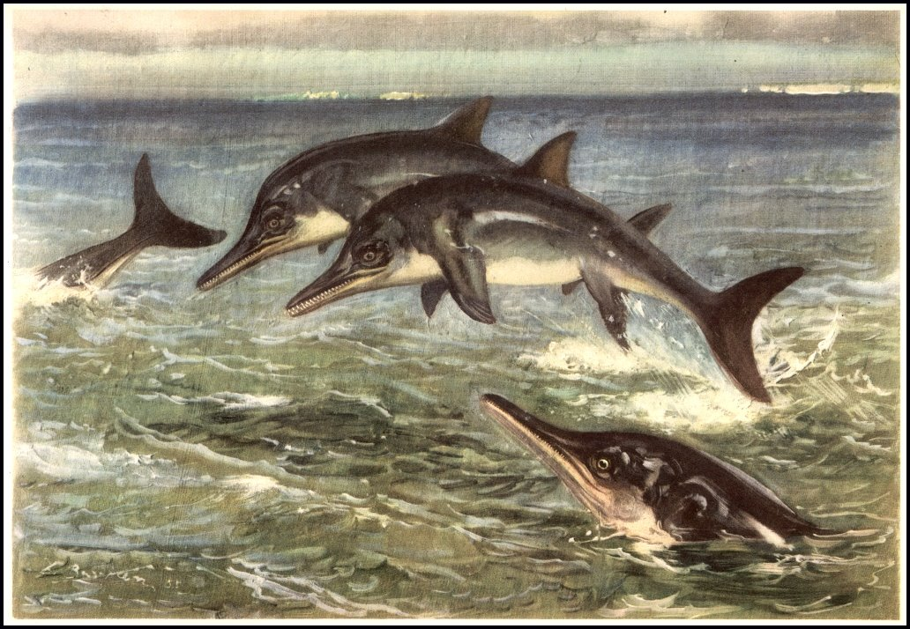
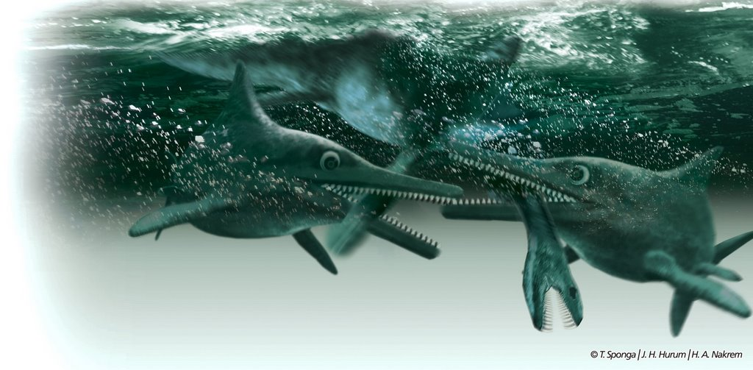
A PowerPoint all about the Ichthyosaurs
This Photo by Unknown Author is licensed under CC BY-SA-NC
This Photo by Unknown Author is licensed under CC BY-SA
This Photo by Unknown Author is licensed under CC BY-NC-ND
This Photo by Unknown Author is licensed under CC BY-NC-ND
This Photo by Unknown Author is licensed under CC BY-NC-ND

Slide 2
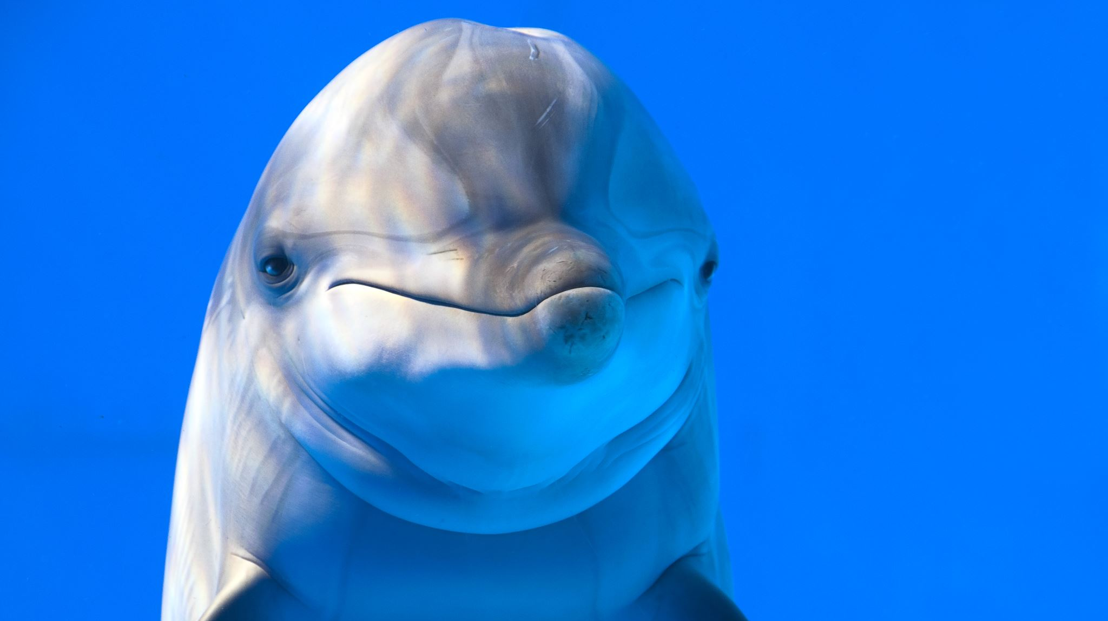
Fact 1 Ichthyosaurs closest living relative is a dolphin.

Slide 3
Question 1. When was the Ichthyosaurus alive?

Slide 4
Answer 1 (190-200 million years ago)

Slide 5
Size and weight: it was about 11ft long and weighed 200 pounds.
This Photo by Unknown Author is licensed under CC BY-SA

Slide 6
Locations to have been found were Europe including, Belgium, England, Germany and Switzerland.
This Photo by Unknown Author is licensed under CC BY-SA

Slide 7
Question 2 What did they prey on?

Slide 8
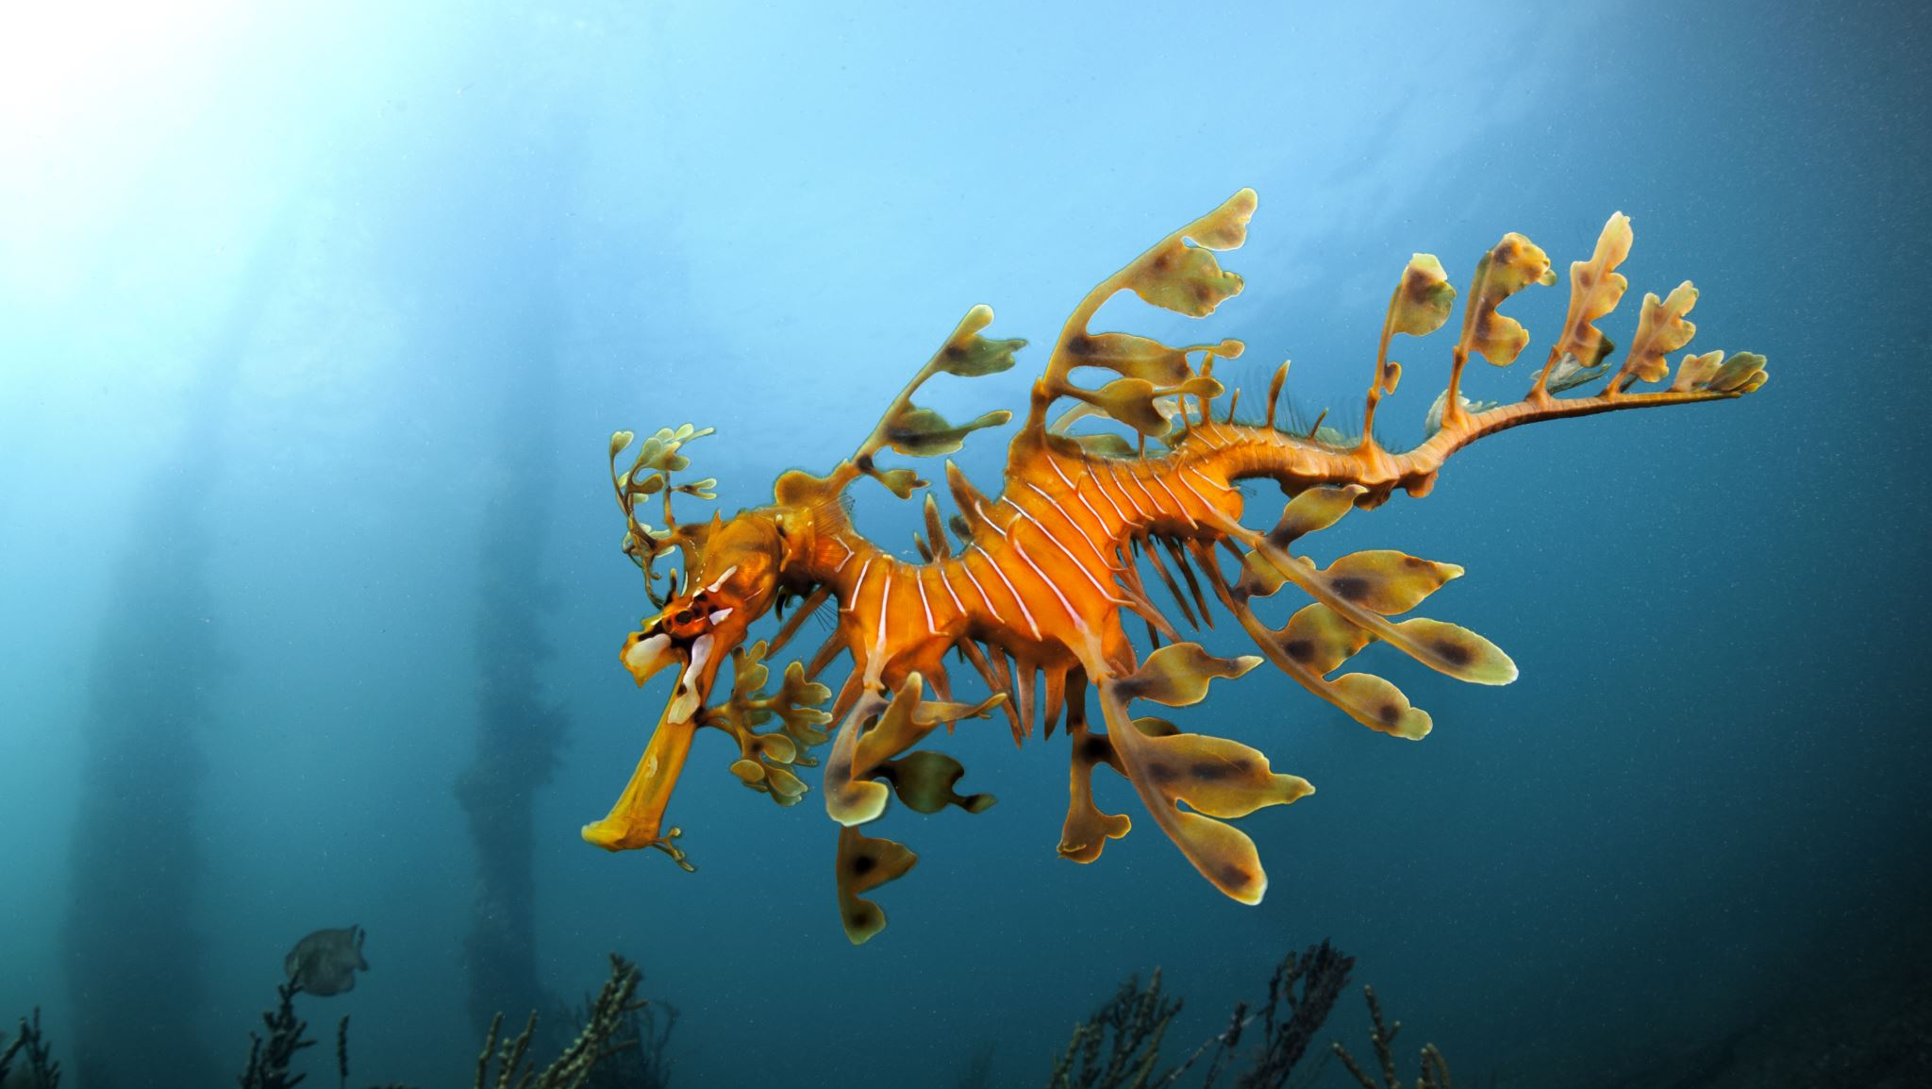
Small fish, squids, and other sea and Aquatic creatures.

Slide 9
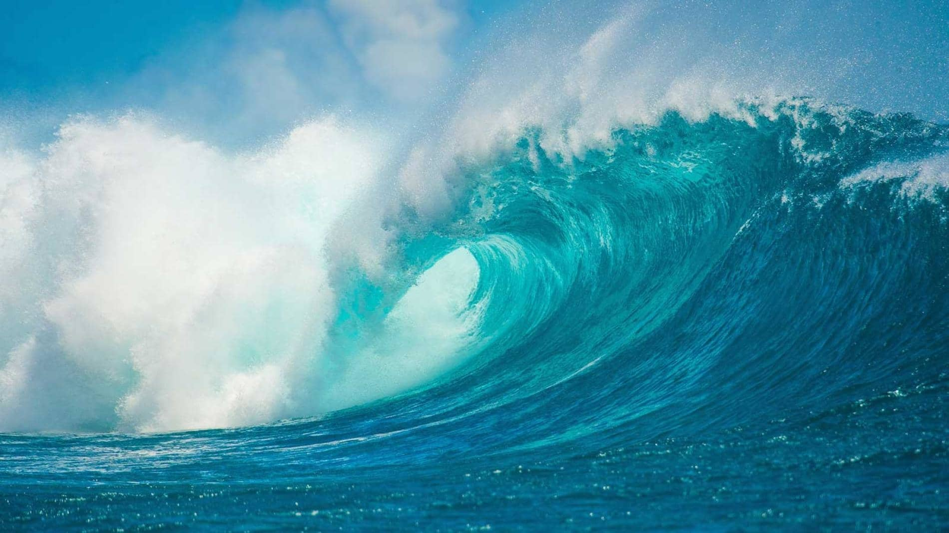
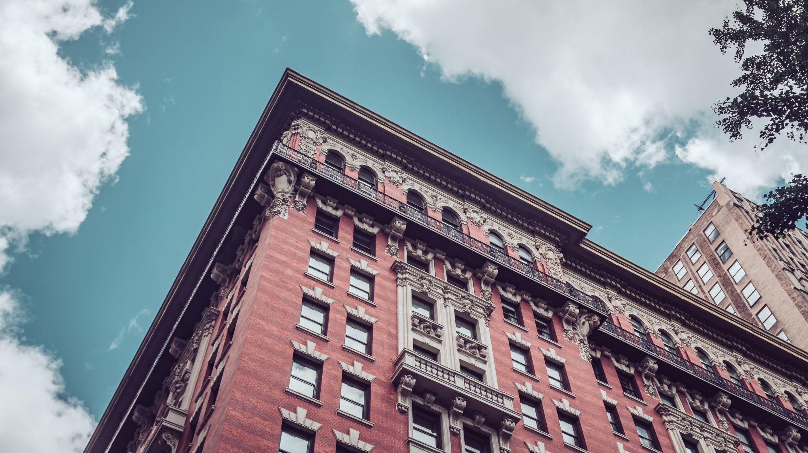
The end from Archie Pickering.
This Photo by Unknown Author is licensed under CC BY-SA

